Slide 1
Customer Interactions With Store Layout
Submitted By
Anuj Verma, Gaurav Marwal, Hitesh Jaware, Vicky Mishra
Team Name
Code Brigade

Slide 2
Overview
This project aims to implement a system to find the amount of time a customer spends in a particular section of places, like a shopping complex. The dataset used in creating this project is of MP4 type, collected from the CCTV of the pet shop.
To achieve the aforementioned aim, we used YOLO V4, an object detection algorithm, to detect customers in the frame. Along with YOLO V4, an OCR(Optical Character Recognition) algorithm named TESSERACT is used to recognize the entry and exit times of the customers from a particular frame in the video.
In the end, entry and exit times for different sections are recorded for different customers and fed into a CSV file, which can be used for further analysis and decision-making.

Slide 3
Understanding the problem
The problem statement can be briefly divided into 3 parts:
01
Object Detection: Being able to generate a model which is capable of identifying a human from the video stream uniquely.
02
Object Tracking: Using an algorithm that’s capable of tracking the detected entity while in motion.
03
Data Extraction: To be able to extract data like current section, previous section and video time using OCR and storing this data into an CSV output file.

Slide 4
Project Objective
The main objective of this project is to identify customers movement uniquely from one section to another section.
Along with the movement, the entry and exit time of the customer is to be recorded as well.
This may assist authorities to take decisions in order to provide better shopping experience to the customers by identifying the sections where people spend more time.

Slide 5
Target audience
Considering the usability of this project, following are the potential target audience:
Big shopping complex, malls, gaming zones, food complex etc.
Owners of gaming zones can use this project to identify which games attract more customers.

Slide 6
Requirements
CMake >= 3.8
CUDA 10.0 (For GPU)
OpenCV >= 2.4 (For CPU and GPU)
cuDNN >= 7.0 for CUDA 10.0 (for GPU)
OpenMP (for CPU)
Other Dependencies: make, git, g++ / Google Colab

Slide 7
Learnings And Challenges
Shift in person unique IDs, assigned using DeepSort, when they overlap.
Algo for detection of entry time and exit time depends on IDs.
Got introduced to yolo v4 and deepsort.
Integration of our custom algo with open source algo.

Slide 8
Methodology
Video data is first converted to image sequence data using OpenCV. We also create 8 sections in the video using OpenCV.
This data is fed into the YOLOv4 model which detects humans in each frame of the video.
Each detection is sent to Deep SORT which tracks the entity in real time in the video.
Simultaneously IDs are assigned to unique detected entities and are tracked using the centroid marker.
Whenever the entity passes over the coordinates of one section to the other the data of its entry time and exit time are pushed to the output csv file.

Slide 9
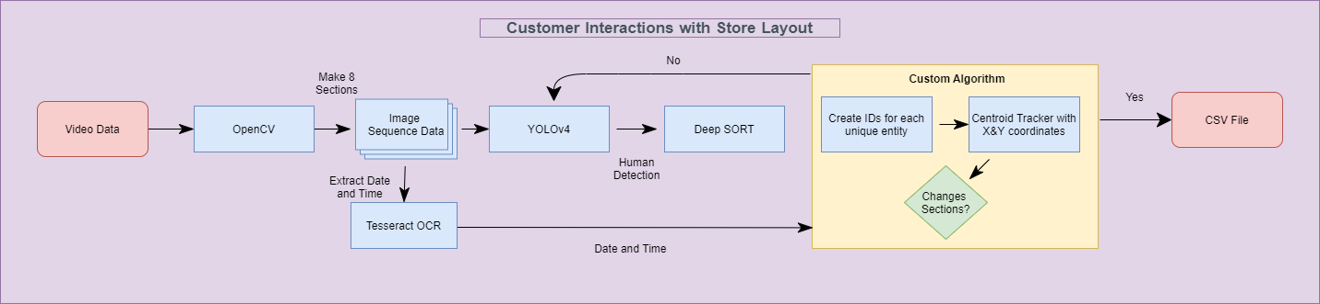
Flow Diagram

Slide 10
Models And Techniques
YOLO v4: You Only Look Once is a real-time object detection system that can recognize multiple objects in a single frame.
Deep SORT: It’s an extension of Simple Online and Realtime Tracking with a Deep Association Metric that is mainly used for object tracking
Tesseract OCR: Tesseract is an optical character recognition engine which helps us to convert image data into text.
Custom Algorithm: Tracking each entity using unique IDs and centroid marker. When the entity’s marker changes sections in the video we push the entry and exit time into the CSV output file along with the entity and section IDs.

Slide 11
Conclusion
We have successfully implemented the project named “Customer Interactions with Store Layout”, by using custom algorithms for section identification and time interval, deep-learning techniques, ocr tesseract etc.
This project can be used to provide better customer experience by analysing the output that leads to effective decision making.

Slide 12
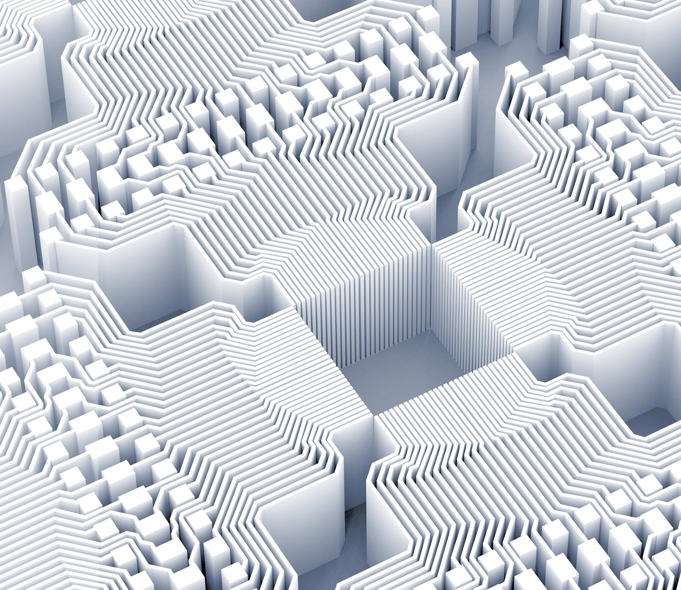
Thank you!

